Slide 1
The Battle of Neighborhoods—Restaurants in Pittsburgh
Peilin Tian
IBM Data Science Capstone Project

Slide 2
Introduction
Pittsburgh is a city with a variety of cultural and historical heritages. The food from most parts of the world is an essential part of them.
For an investor, he/she may be interested in the type of restaurant one should open in a specific neighborhood based on the most popular kinds of restaurants in the area.
As a consumer, he/she would like to know where to go for a specific type of restaurant.

Slide 3
Data
Zip codes and their coordinates of Pittsburgh neighborhoods can be obtained from some internet sources.
US Zip Code Latitude and Longitude [https://public.opendatasoft.com/explore/dataset/us-zip-code-latitude-and-longitude/table/], specifically the data of Pennsylvania would be used.
Restaurant information would be obtained through Foursquare API using the coordinates from the geo spatial information of each neighborhood.

Slide 4
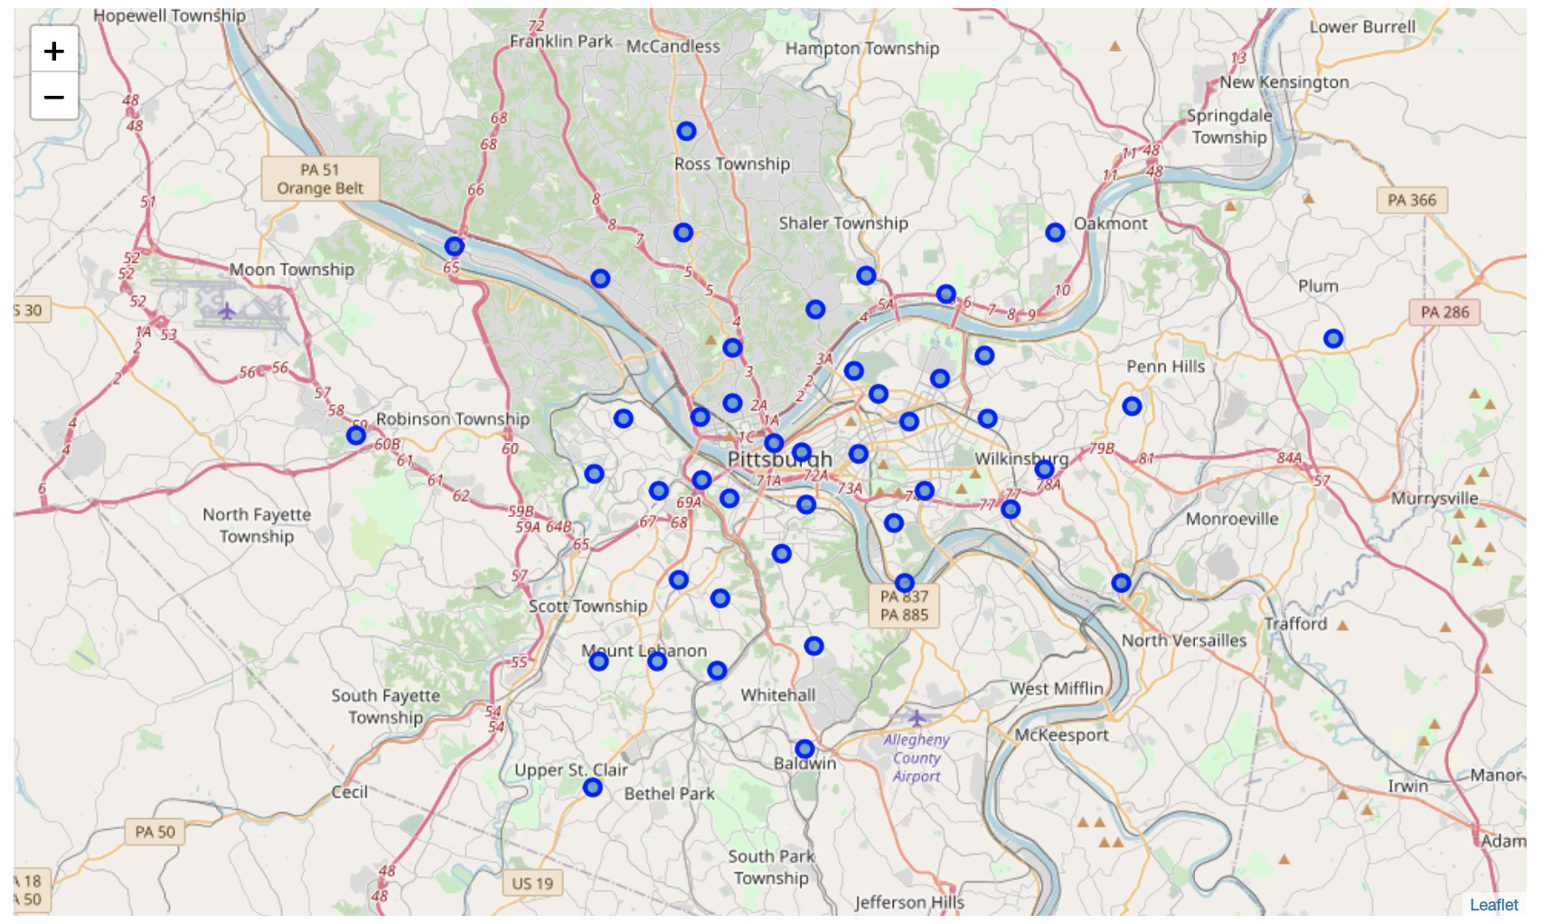
Methodology
In this project, we will use the zip codes of each neighborhood in Pittsburgh and their corresponding coordinates along with the venue data from Foursquare API to cluster them into different clusters based on the patterns of popular restaurant types in each neighborhood using K-means clustering.

Slide 5
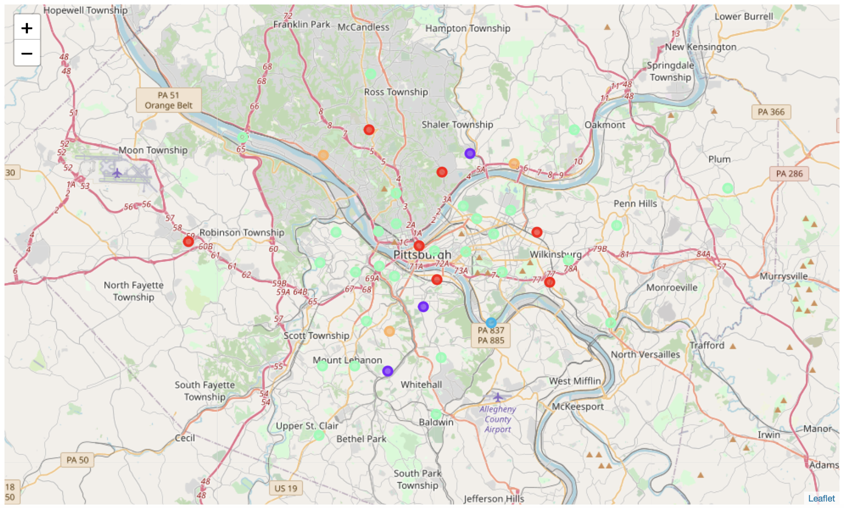
Results and Discussions
The neighborhoods are divided into five clusters based on the popular types of restaurants in them. Each clusters are analyzed based on their pattern.
Cluster 1: Fast food and American Cluster 4: Vietnamese and Mediterranean
Cluster 2: American and Mediterranean Cluster 5: Italian
Cluster 3:Seafood (not enough data)

Slide 6
Conclusion
In this project, the neighborhoods of Pittsburgh are clustered into different clusters based on the popular types of restaurants in it. If someone wants to open a new restaurant, he/she should avoid the popular choices and aim for the less popular kinds, for example the 4th or 5th ones instead. For consumers, this clustering is also inspiring if they want to find the best restaurant for a specific type. They will know where to go to have the best chance finding a good one.

Slide 7

Thank you!

